Slide 1
Cricsheet Match Data Analysis
Exploratory Data Analysis Using Python & SQL
Name: Uma Rajesh
Project Type: Data Analysis + Visualization
Dataset Source: Cricsheet.org (via SQLite DB)

Slide 2
Project Objective
Objective:
Analyze international cricket matches (ODI, Test, T20)
Extract insights using SQL queries
Visualize patterns across formats, cities, and players
Tools Used:
SQLite, Python (pandas, matplotlib, seaborn)
Jupyter Notebook

Slide 3
Dataset Overview
Database: cricket_data.sqlite
Tables Used: test_matches, odi_matches, t20_matches
Records Analyzed: ~1500+
Key Fields:
player_of_match, city, gender, result, overs, outcome, etc.

Slide 4
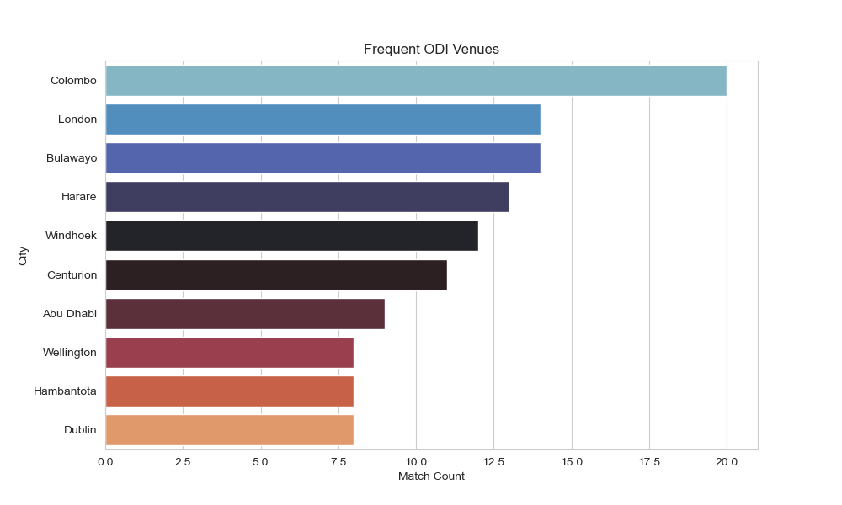
ODI Match Analysis – Frequent Venues
Insight: Colombo and London lead as top ODI venues, with African cities like Bulawayo and Harare showing high ODI activity too.

Slide 5
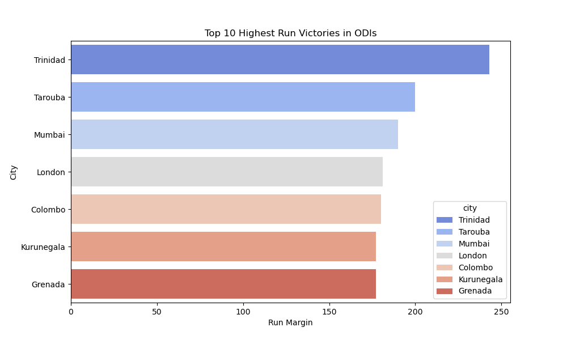
ODI – Highest Run Victories
Insight: Trinidad, Tarouba, and Mumbai recorded the biggest run-margin wins in ODIs, highlighting strong team performances at these venues.

Slide 6
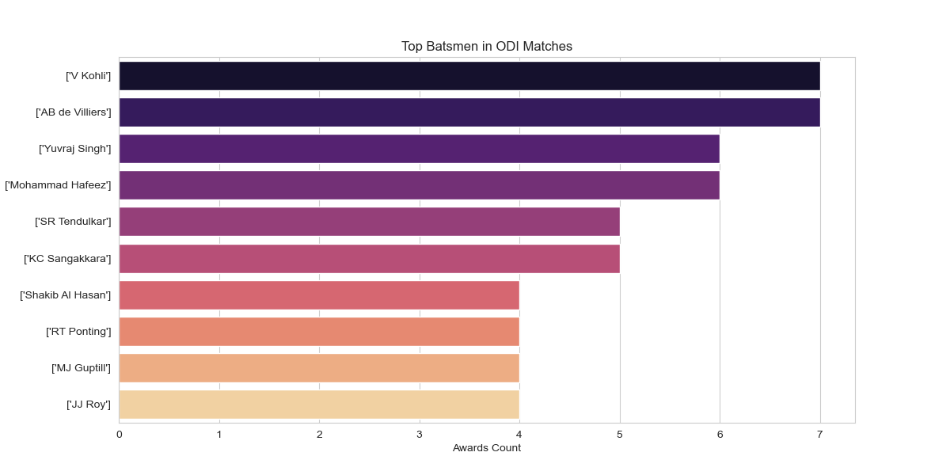
ODI – Top Batsmen
Insight: Virat Kohli and AB de Villiers top the ODI batting charts based on match awards, followed by Yuvraj Singh and Mohammad Hafeez.

Slide 7
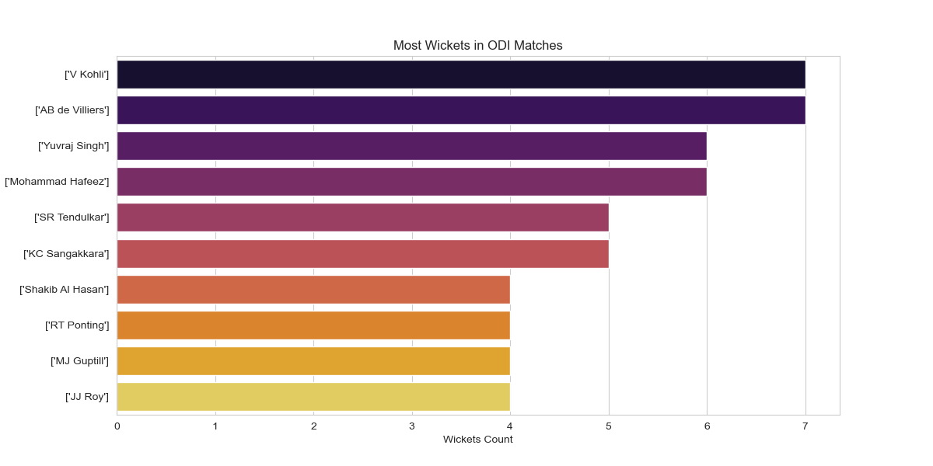
ODI – Top Wicket-Takers
Insight: Surprisingly, many all-rounders like Kohli, AB de Villiers, and Yuvraj Singh also appear in the top wicket-takers list, showing their diverse roles.

Slide 8
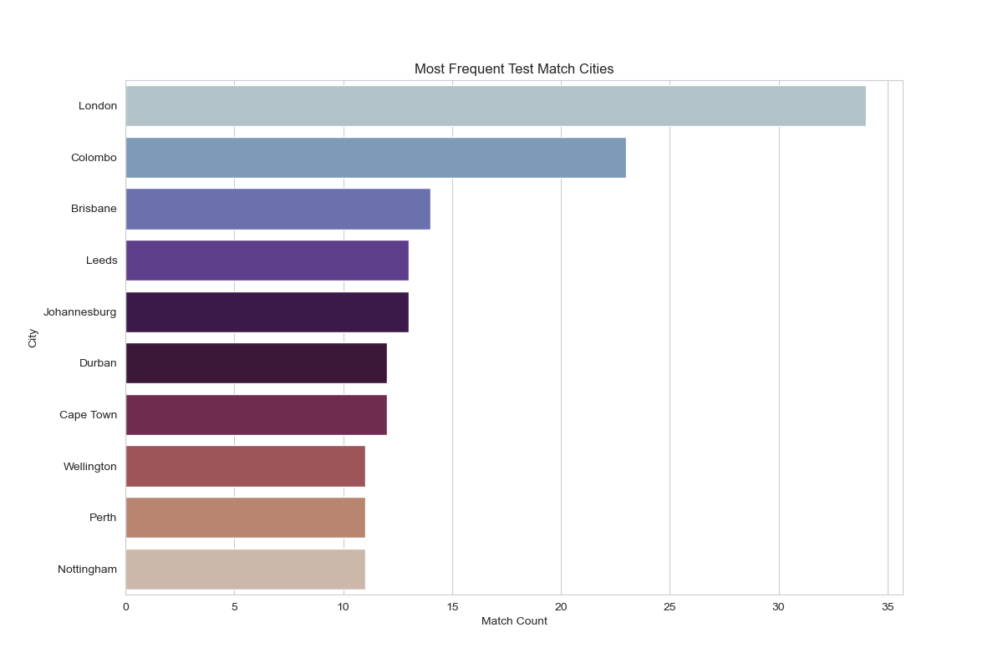
Test Match Analysis – Most Frequent Cities
Insight: London hosted the highest number of test matches, followed by Colombo and Brisbane.

Slide 9
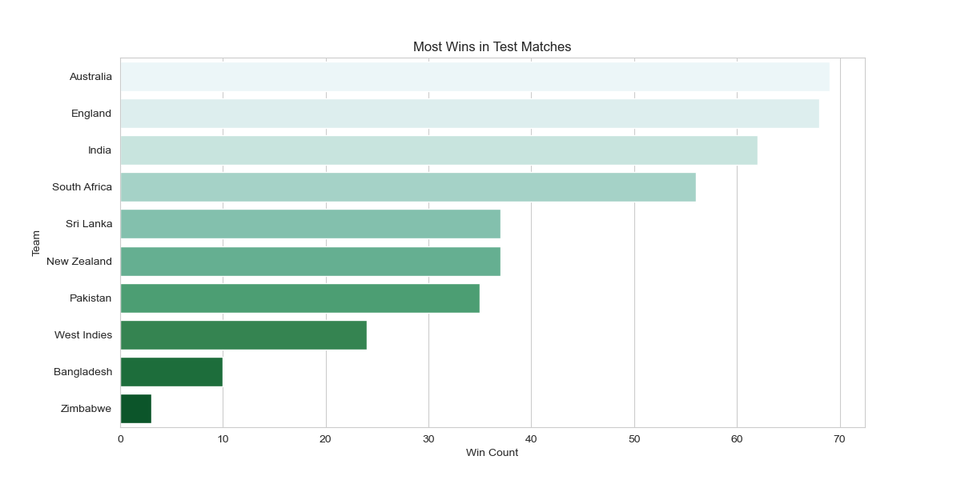
Test Matches – Most Wins by Country
Insight: Australia and England lead with the most test victories, showcasing their historical dominance in red-ball cricket.

Slide 10
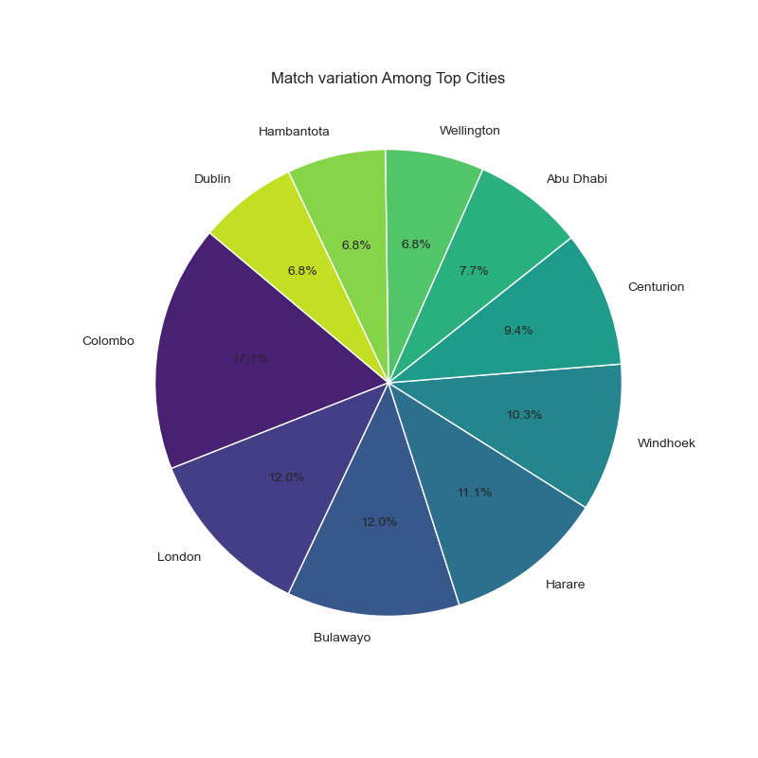
Test Matches – City-Wise Variation
Insight: Pie chart showing match share across top cities. Colombo stands out with the highest share.

Slide 11
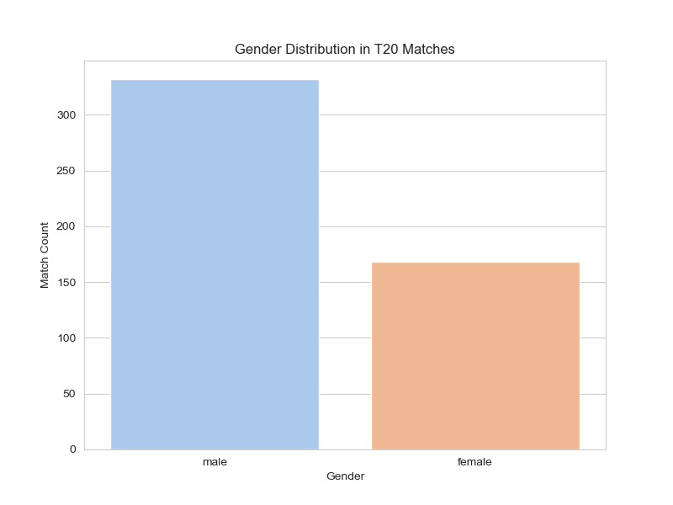
T20 Match Analysis – Gender Distribution
Insight: T20 matches are more male-dominated, with nearly double the number of male matches compared to female matches.

Slide 12
Summary of Findings
Cities like London and Colombo are central to both Test and ODI cricket.
Male matches dominate T20 format, but women’s matches are growing.
Key Players like Kohli, AB de Villiers, and Yuvraj Singh appear in both batting and bowling charts.
Australia and England dominate Test wins.

Slide 13
Thank you
Project: Cricsheet Match Data Analysis
By: Uma Rajesh
Tools: Python, SQL, Matplotlib, Seaborn

